Slide 1
Unocoin
INDIA'S MOST POPULAR BITCOIN COMPANY

Slide 2

Mission statement: Cashless Indian Economy - A step towards Digital India

Slide 3
The problem
Promoting the use of Bitcoins through UNOCOIN as a payment method
Introducing new features
Extending the functionality of existing UNOCOIN system
20XX | 20XX | 20XX | 20XX

Slide 4

The solution
Uniform Payment Gateway
A chrome extension that lets you shop “ANYWHERE” with your Unocoin Wallet

Slide 5
Overview
The proposed system provides an interface for a payment gateway to pay Bitcoins through Unocoin for Unocoin merchants as well as Non-Unocoin merchants
Using the proposed system, Unocoin wallet can be used with any merchant that accepts Bitcoins, thus extending the reach of Unocoin to practically everywhere

Slide 6
What all it provides?
No restriction for the use of Unocoin wallet only for Unocoin merchants
Common interface for all merchants
More user friendly
Secure transactions

Slide 7
How it works
Step 3
Step 2
Step 1
Complete payment using SendBTC
Check Unocoin Balance, If Balance < Amount : INR Deposit
Proceed to pay and Authenticate

Slide 8
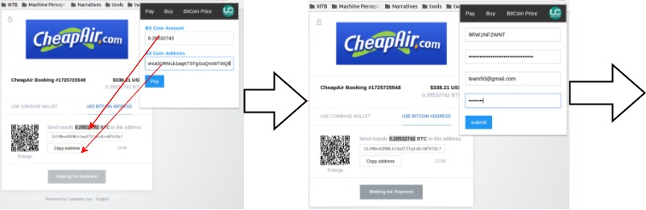
Workflow: Proceed to Pay and Authenticate

Slide 9
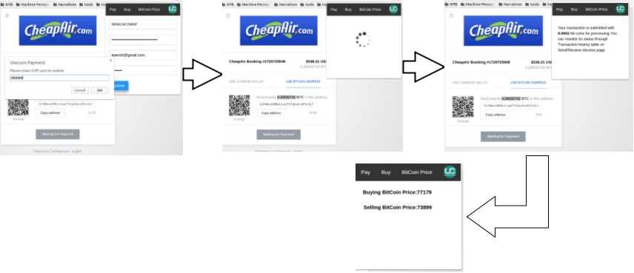
Workflow: Proceed to Pay and Authenticate

Slide 10
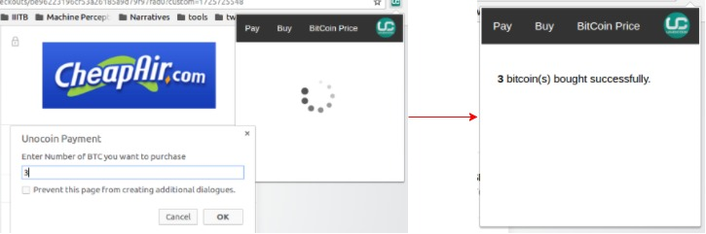
Buy BitCoins Workflow

Slide 11

Tech-Stack:
JavaScript + Node.js

Slide 12
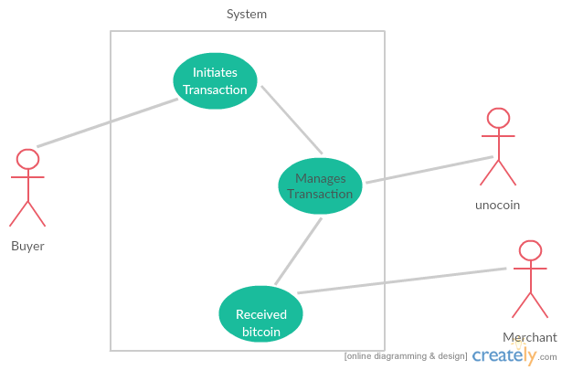
Use Cases
Actors:
Buyer: User having Unocoin address and bitcoins in the wallet
Merchant: Accepting bitcoin payment
PreConditions:
User must be having valid Unocoin account
Flow:
User logs in to Unocoin account
2 level authentication using OTP

Slide 13

Security
Two level Authentication using credentials verification and OTP for every transaction
Reduced risk of eavesdropping and password based attacks by avoiding cache storage of client credentials

Slide 14
Queries??

